Slide 1
TKT Project Whitepaper
UofT Fintech Project 3
Group 2: Beni Shankar De, Avneet Singh, Aakshay Gautam, Tarun Midha, Juil Yoon

Slide 2
Executive Summary
TKT is a ticket sale and management application built with ERC721 NFTs on the Ethereum Network.
TKT offers a secure and transparent platform for both event attendees and organizers alike. Because TKTs are minted on the Ethereum blockchain, transactions are immutable and attendees have total ownership of TKTs in their wallet, while organizers can guarantee authenticity.
TKT aims to decentralize and disrupt the $60+ billion global ticketing industry.

Slide 3
Approach

Slide 4






Slide 5
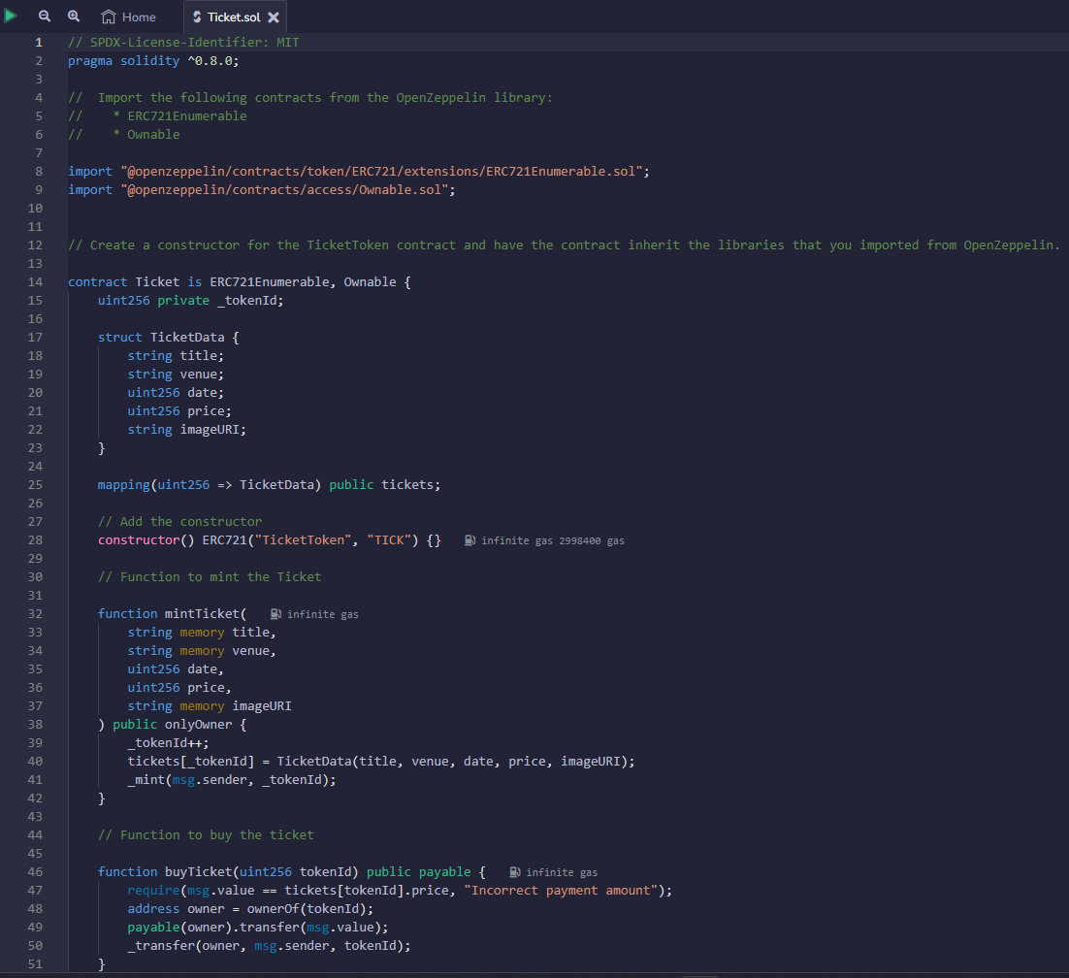
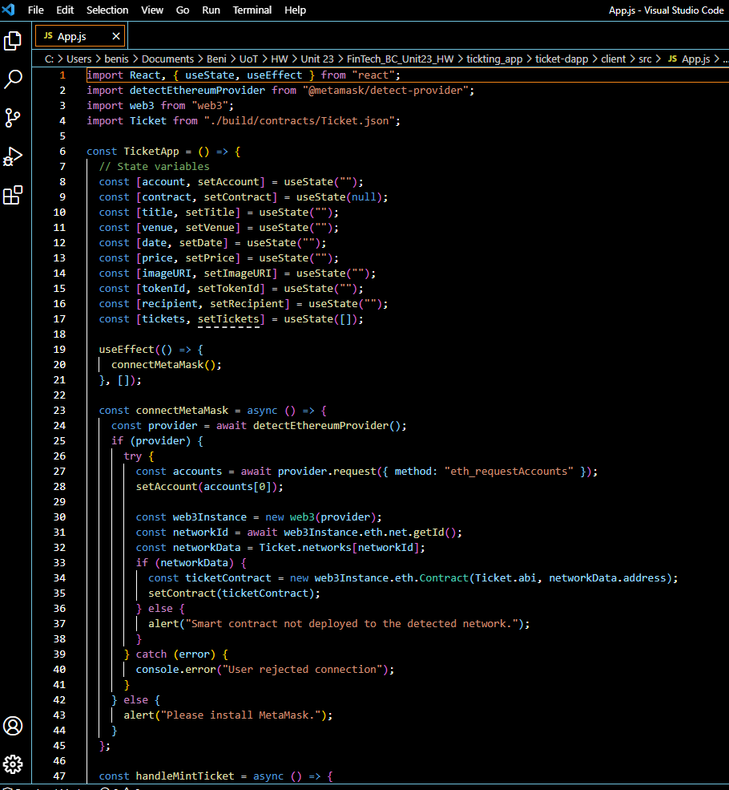
Code snippets
Solidity contract
React JS

Slide 6
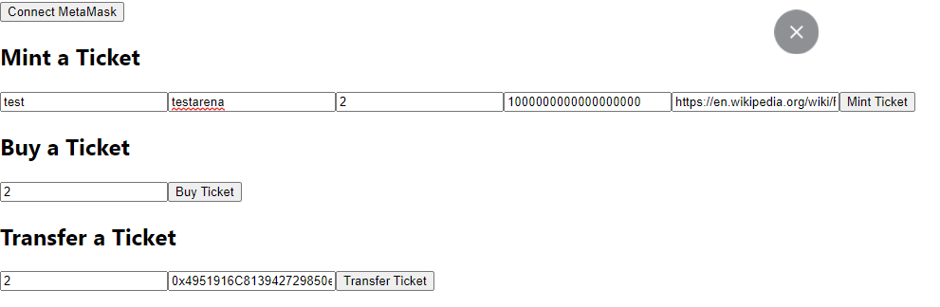
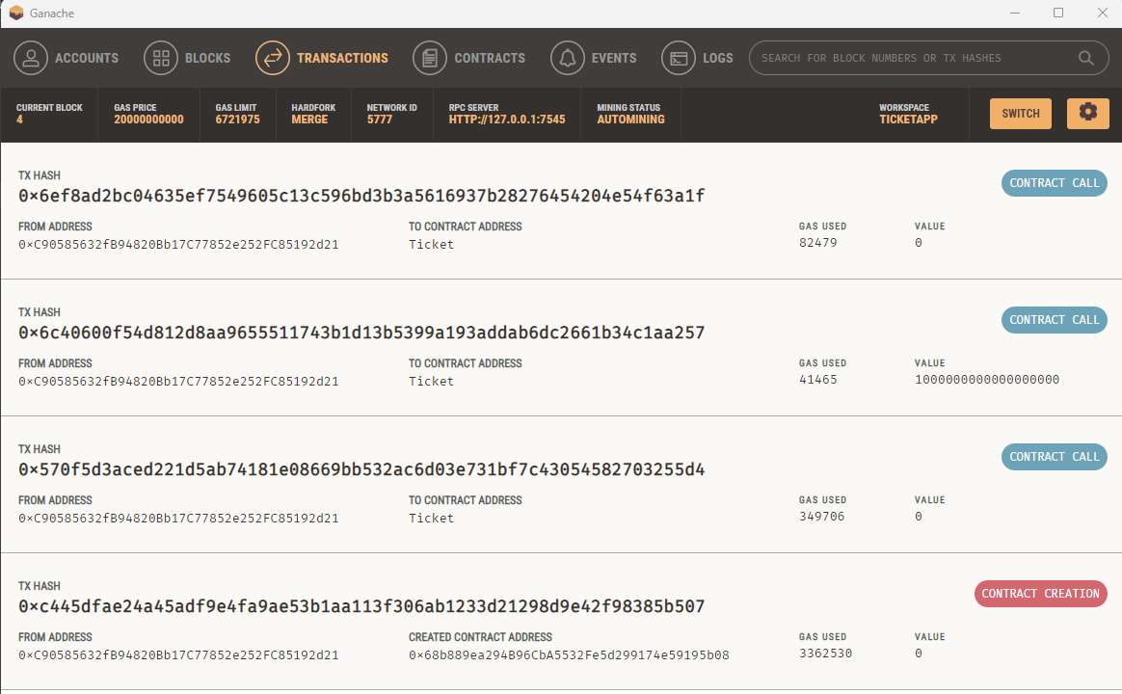
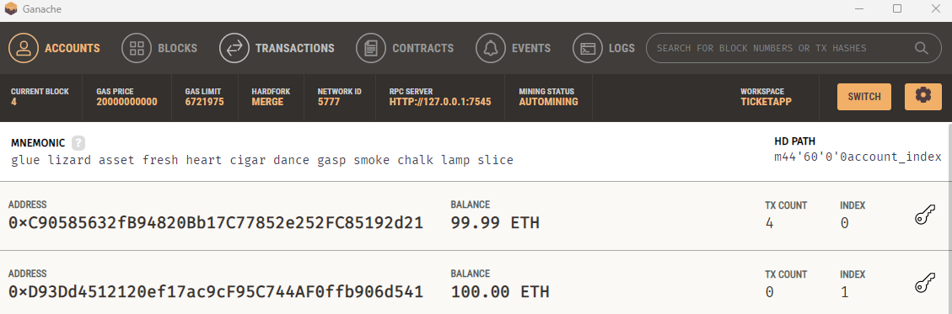
Results
Application screen to Mint a Ticket and Buy /Transfer
Ganache showing the transactions happened

Slide 7
NEXT STEPS

Slide 8
User Interface
TKT was built as an MVP (Minimum Viable Product) to start to make sure that the smart contract is working and there is interest in the product.
There is a lot of room for UI improvements including:
Design
Layout
Function descriptions
Separate pages

Slide 9
LIVE UPDATES
Because all transactions of TKTs are published to the ETH blockchain, the TKT app will be able to track and display all sales and secondary sales of TKTs and how much they were sold for. This will also help inform Marketplace buyers and sellers.
Event organizers will be able to gauge interest and also price tickets to match market value, making sure they are able to sell out with maximum profit.

Slide 10
MARKETPLACE
One of our team’s unfinished goals.
Because TKT ownership is permanent and publicly trackable, the TKT app aims to cut out scalpers and become the central marketplace for buying and reselling TKTs.
By providing a trusted marketplace where regular TKT holders can sell TKTs they can no longer attend or want to attend, scalpers cannot price gauge attendees.
ERC-2981 also allows secondary sales royalties to be paid to the event organizer and/or artist.

